Slide 1

Performers and Programs Database Webinar.
Friday October 22, 2021, 11:00 AM to Noon.
Presented by Peter Kowalski
with an introduction by Sharon B. Phillips,
Youth Services Program Manager, New York State Library

Slide 2

Welcome!
Today’s program is part of the Summer Reading
at New York Libraries statewide initiative.
For Summer Reading information, please visit https://www.nysl.nysed.gov/libdev/summer/index.html
Find the Performers and Programs database at https://performersandprograms.com/index.html
This webinar is supported in large part by the Library Services and Technology Act (LSTA) funds that were awarded to the New York State Library by the Institute of Museum and Library Services (IMLS).

Slide 3
Housekeeping Reminders
Microphones will be muted for this webinar. Please ask questions via chat. Be sure to select “To: Everyone” when posting a question.
If the PowerPoint isn’t formatting correctly on your screen, select “Fit to Screen” under view options.
We will be asking you to complete a brief survey at the end of this program.
This webinar is being recorded and will be archived on the State Library Webinar page.

Slide 4
Today’s Speaker
Peter Kowalski
Pete Kowalski has worked on all aspects of web development during his career. Starting at the Upper Hudson Library System as a web developer, he was approached to assist in the development of the NYS Performers and Programs website. Since then, he's worked in various industries, but usually in healthcare or education technology sectors, having worked at hospitals, textbook publishers, and research institutions. In his spare time, he enjoys tinkering with new technologies.

Slide 5
What does the database offer?
Performers advertise programs available to different regions
Programs are categorized
Virtual programs available!
Performers reviewed before being listed
Robust searching

Slide 6
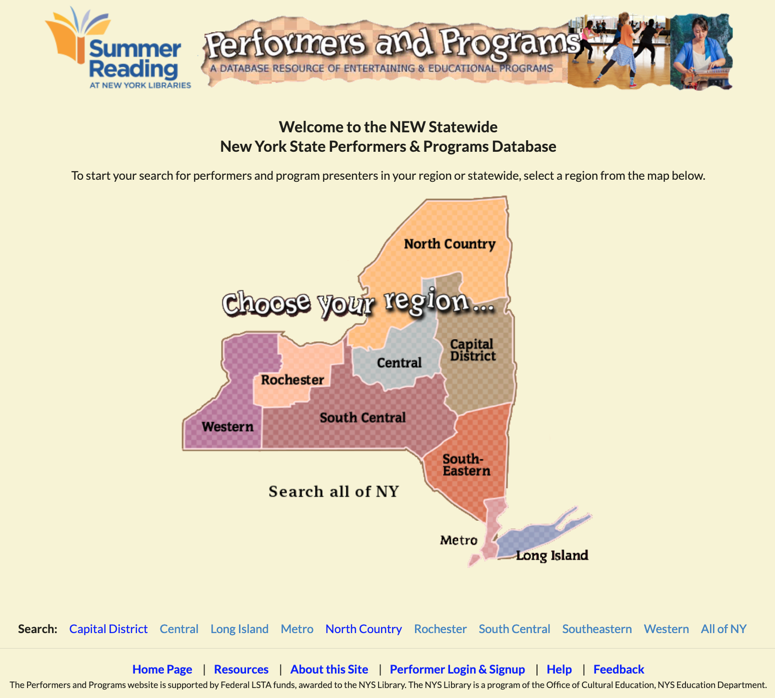
Home Page
List of Regions
Hovering shows counties
Search entire state
Performer login & signup

Slide 7
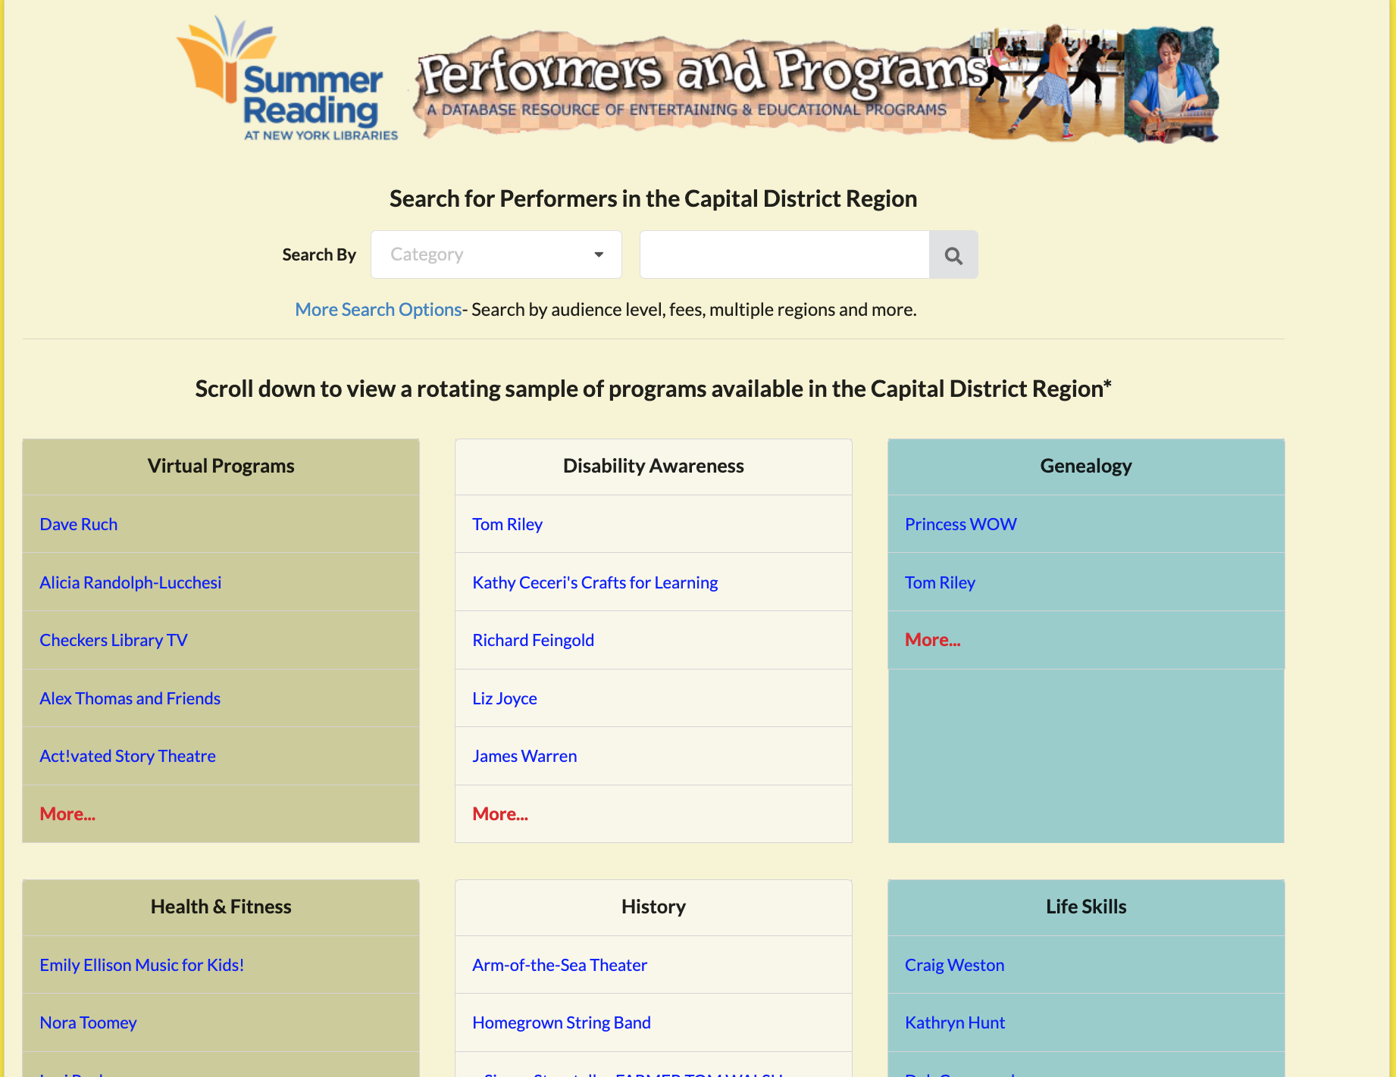
Browsing Categories
16 Categories
Randomized program list
  Exposure to different programs
  Fairness to all performers
Basic search
  Category
  Performer name, program name, description

Slide 8
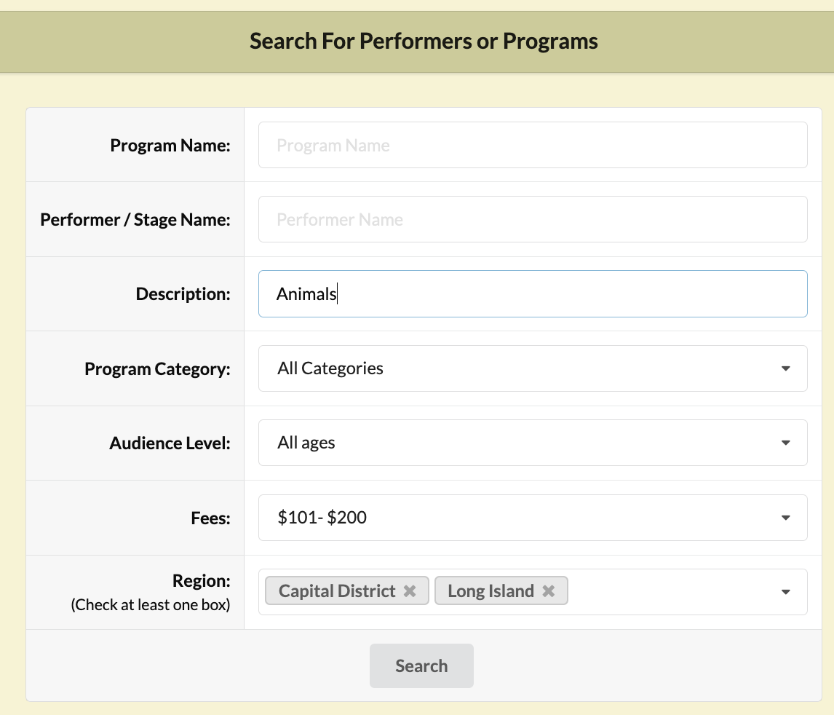
Advanced Searching
Fine tune your search
More options
  Audience level
  Program fee
  Regions

Slide 9
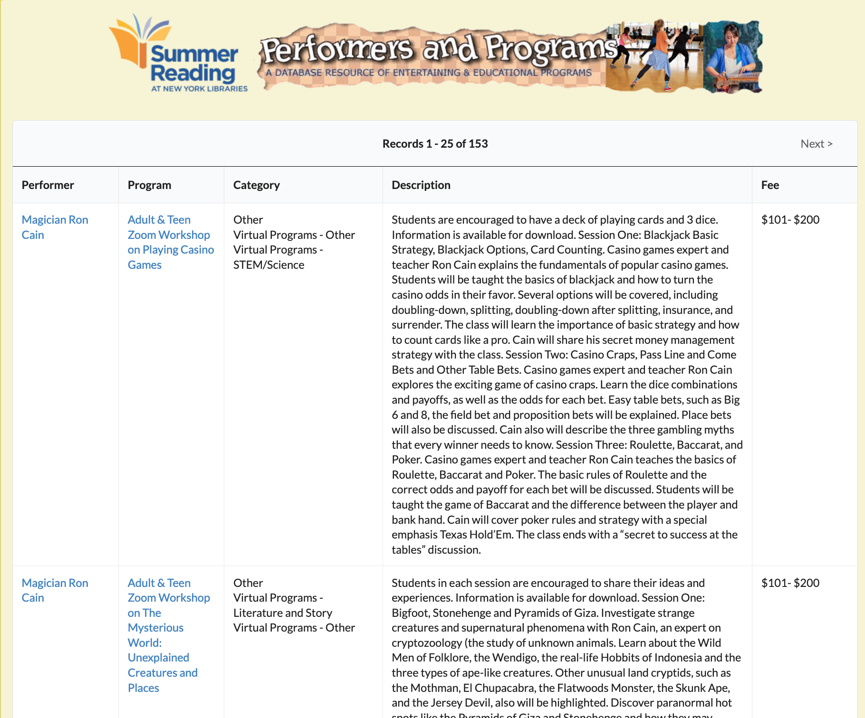
Program List/Search Results
Basic info for quick review
Sorted by performer
View performer or go directly to program

Slide 10
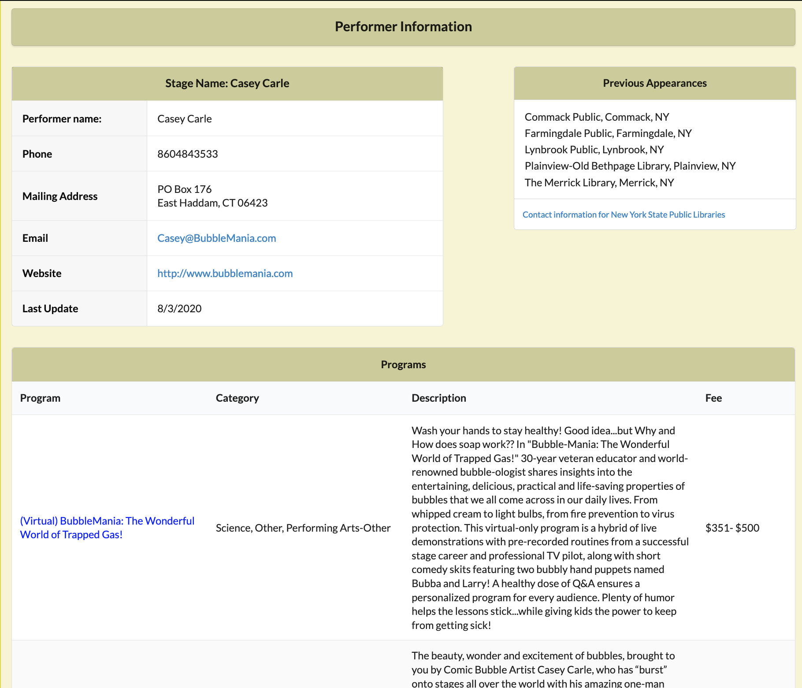
Performer Information
Contact Information
Previous Appearances
  Verify and get real reviews!
List of programs

Slide 11
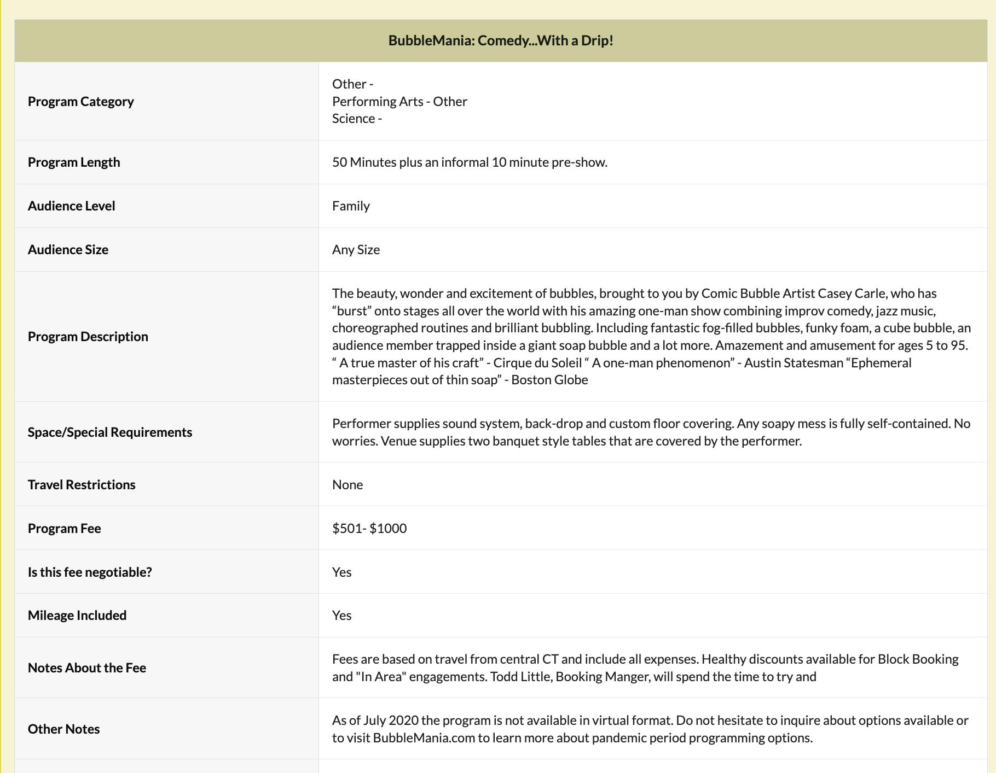
Program Information
More details
Program Information
Requirements
  Space, materials, etc.
Fee information
  Flat fee/negotiable
  Travel Information

Slide 12
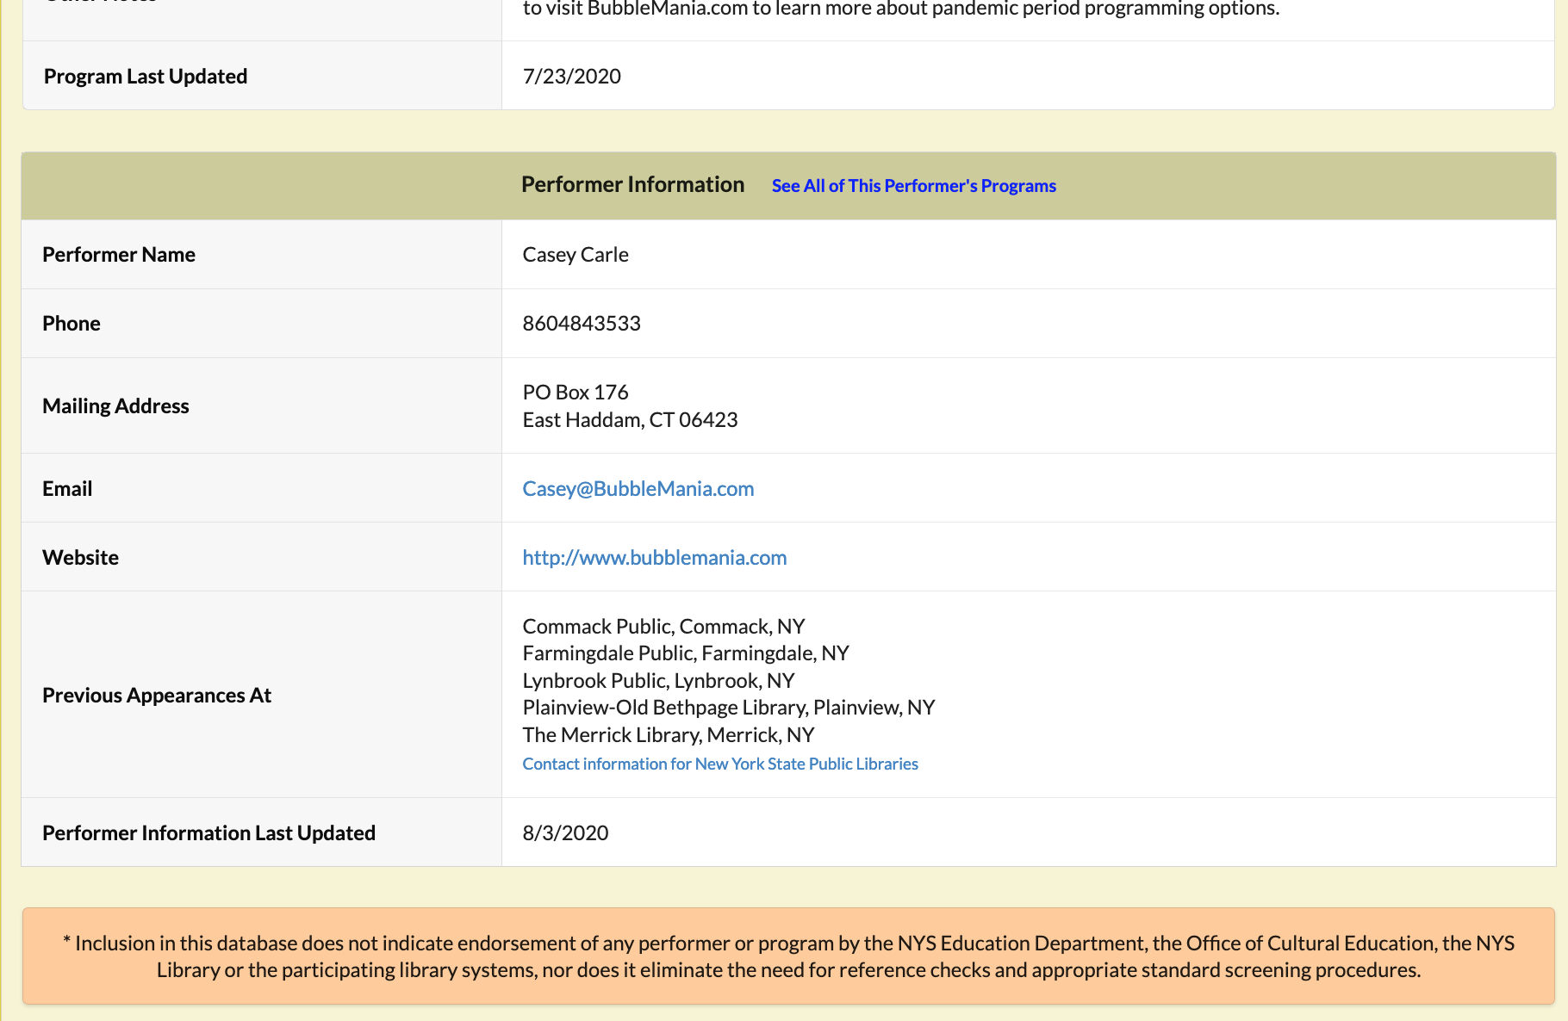
Program Information (cont’d)
Performer Information

Slide 13
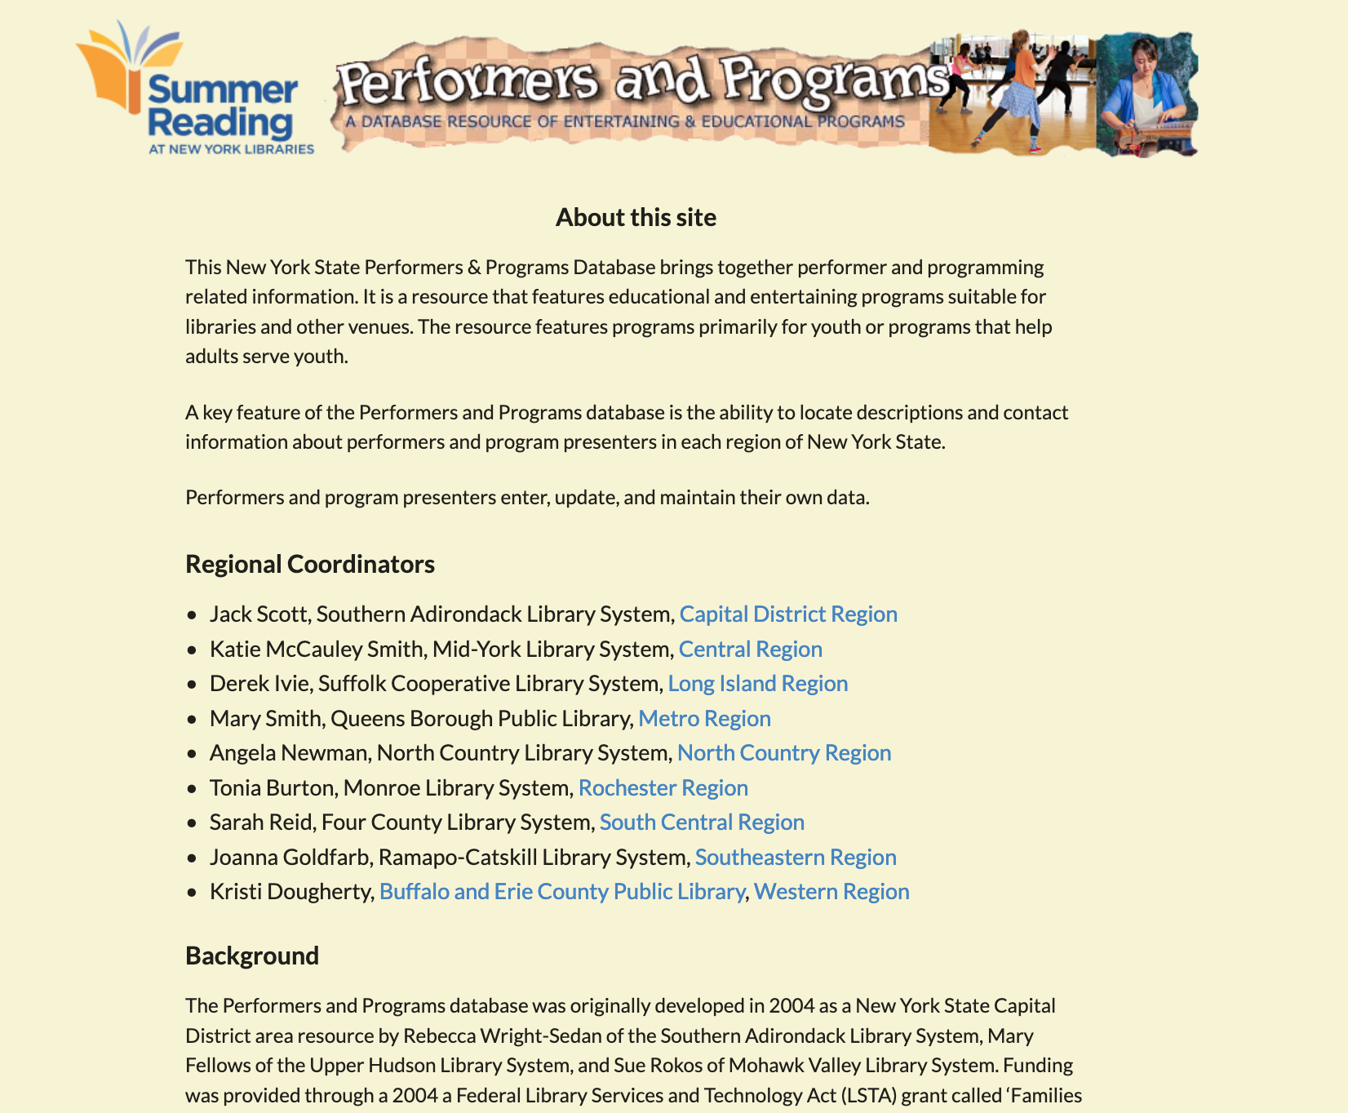
About
History of the site
Regional Coordinators
  Review and approve new performers
  Answer your questions

Slide 14
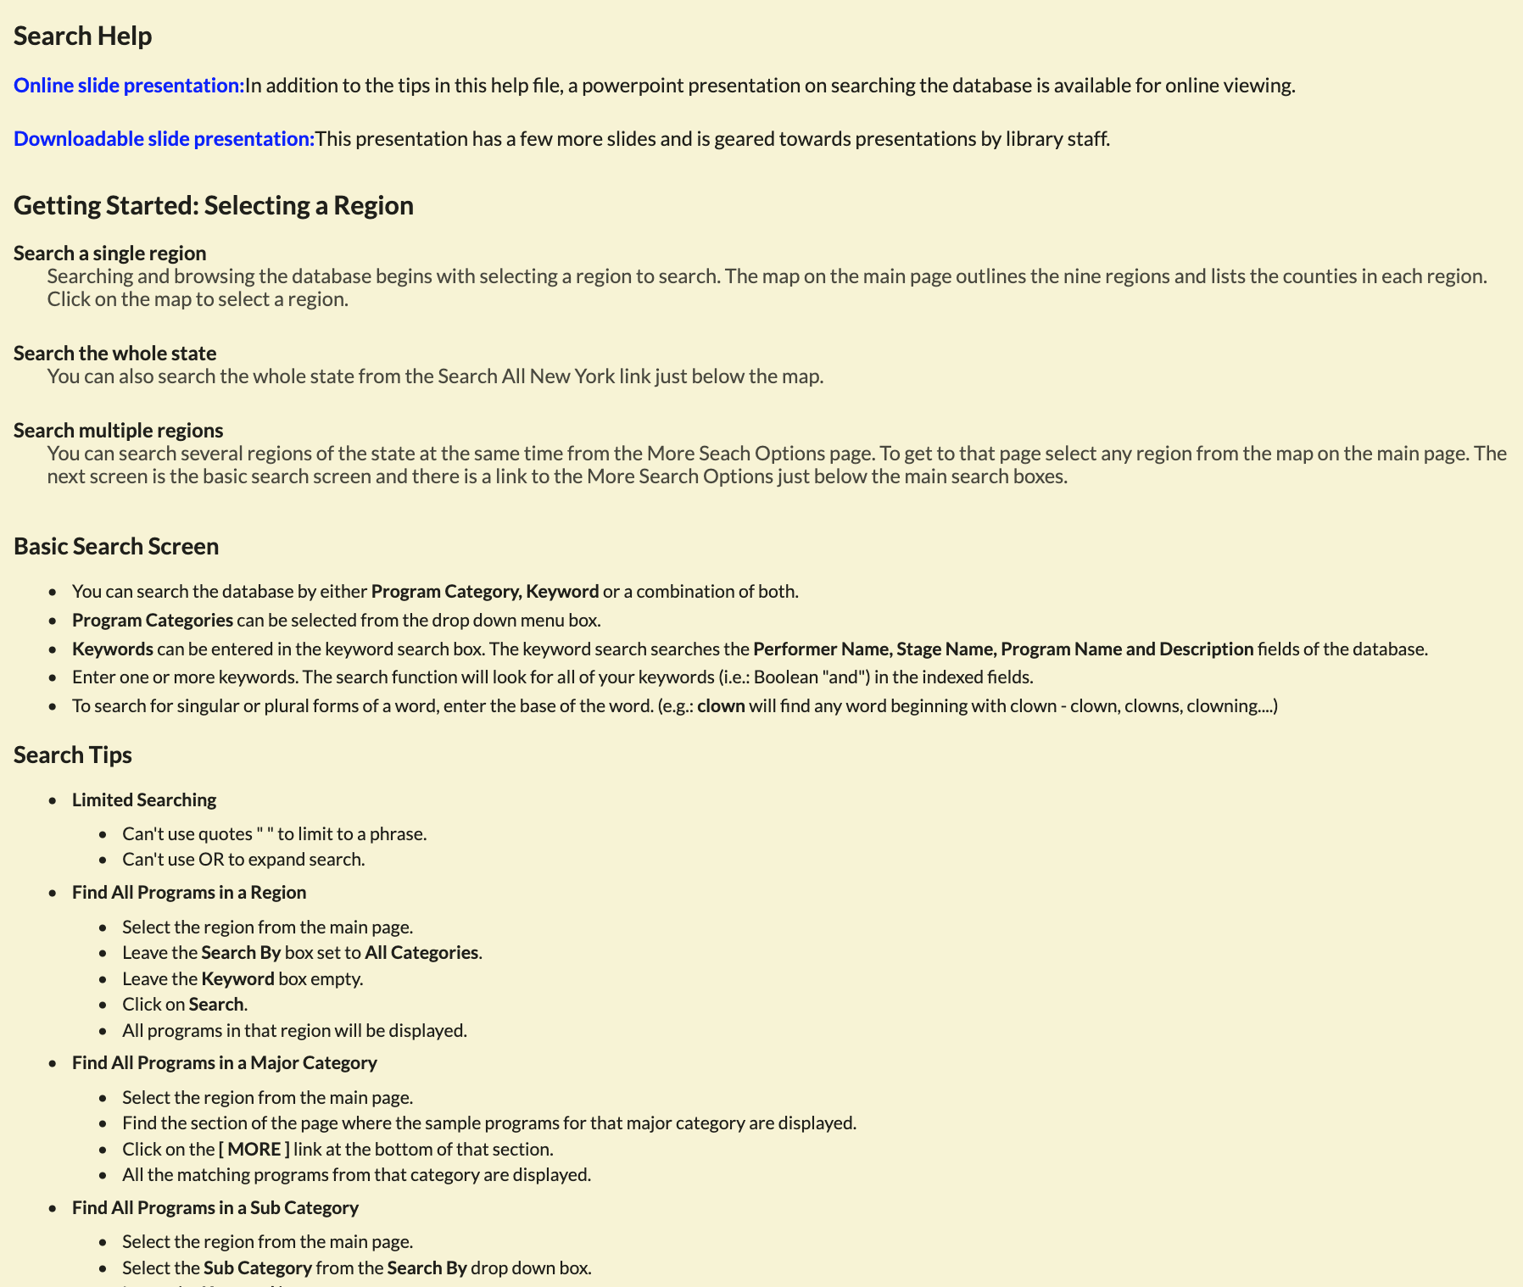
Help
Search tips and tricks
(old) Presentation giving overview of different features
  Outdated images, but mostly up to date information

Slide 15
Questions on the public searching interface?

Slide 16
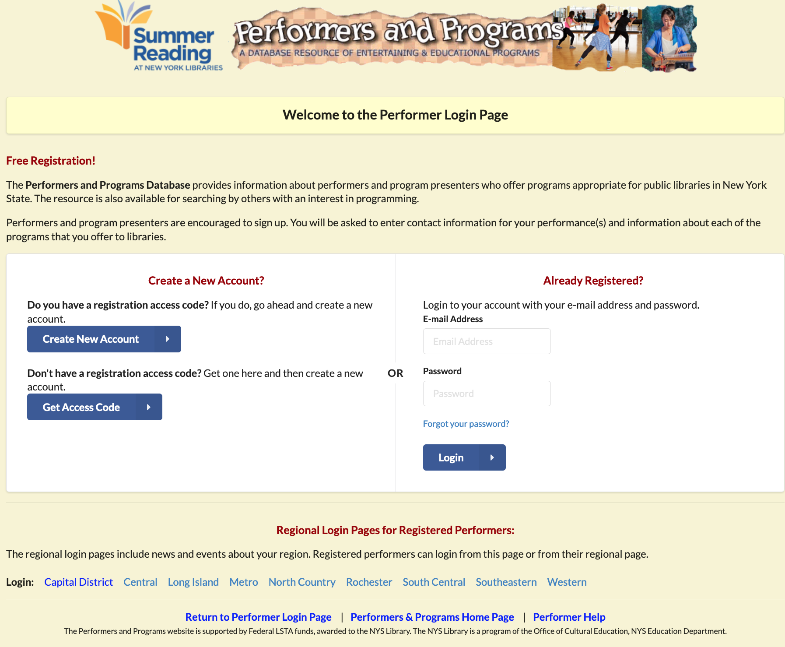
Performers Page
New performer signup
Login

Slide 17
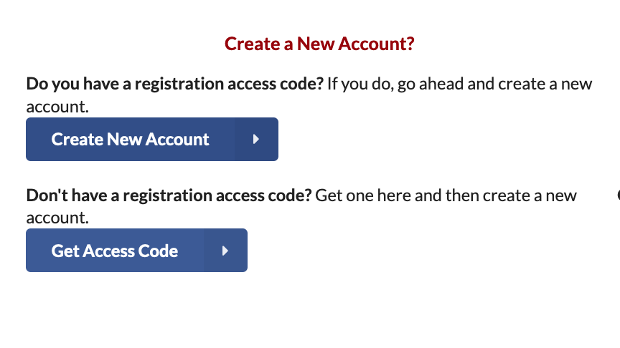
Signup
Needs Access Code
  Verifies email address
Create account after getting code

Slide 18
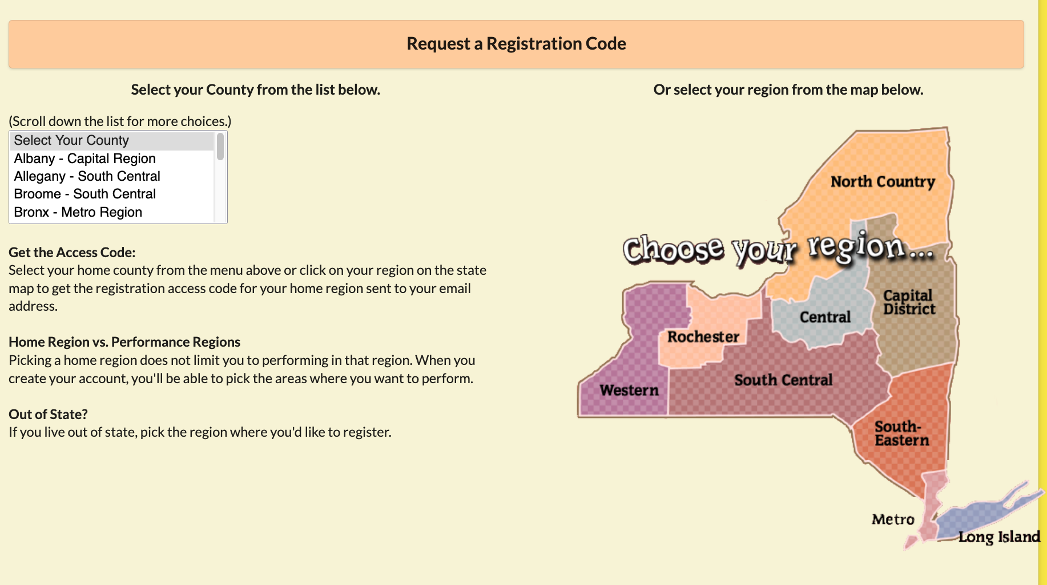
Getting an Access Code
Select your home region
“Home” region is where performer is headquartered
“Performance” region is anywhere willing to perform
Emails code

Slide 19
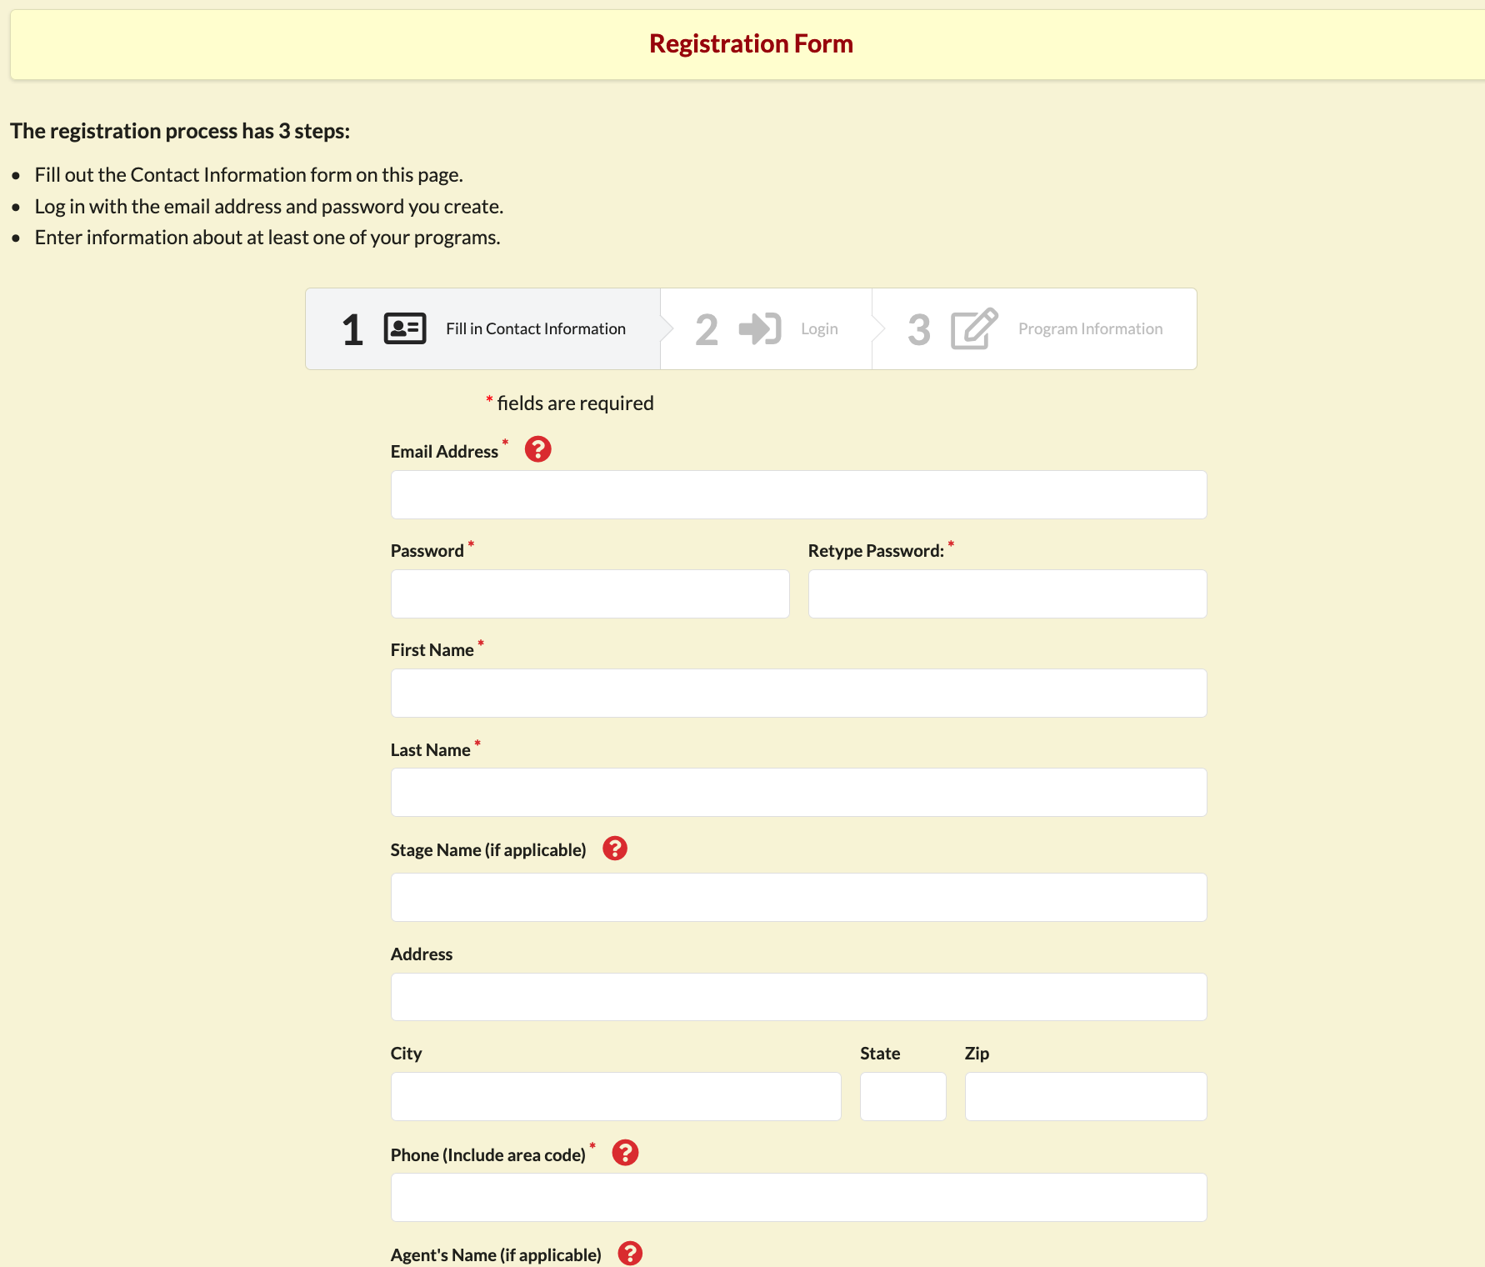
Registering Step 1
Enters in contact information
Help/more info on certain fields

Slide 20
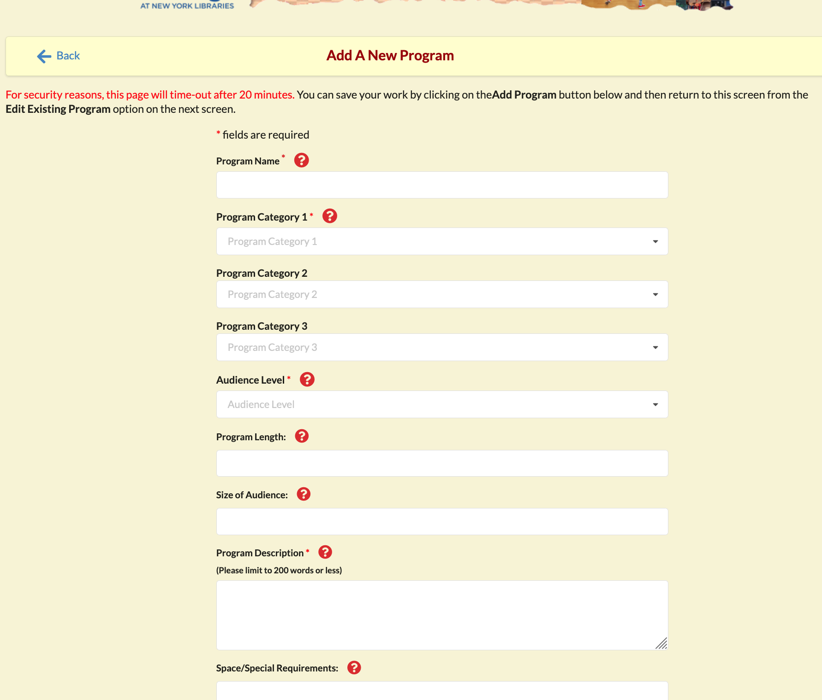
Registering Step 2
User logs in
Prompted to enter a program
  Required to be approved by admin

Slide 21
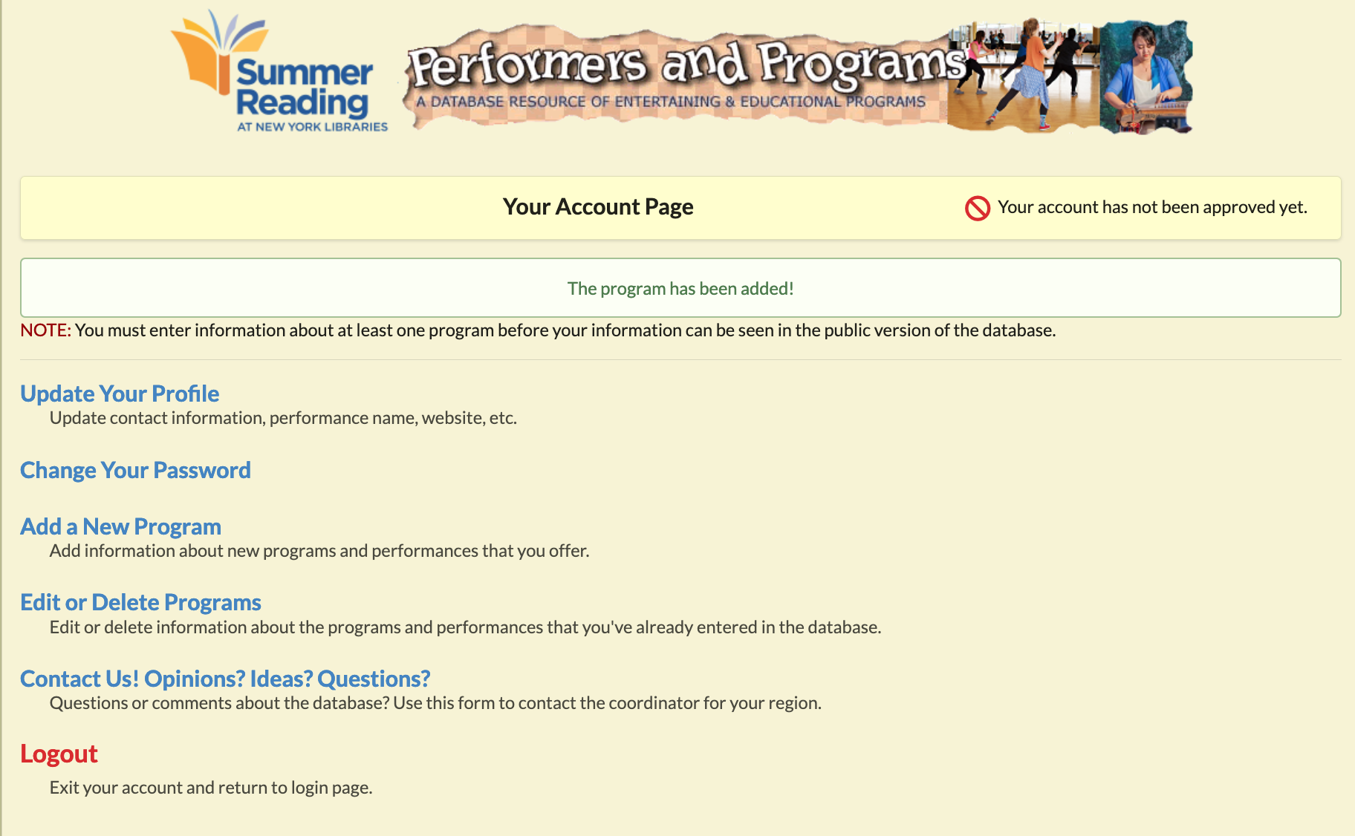
Performer Home
Indicates approval status
  Not listed on site until approved
Program administration
Profile updates
Feedback

Slide 22
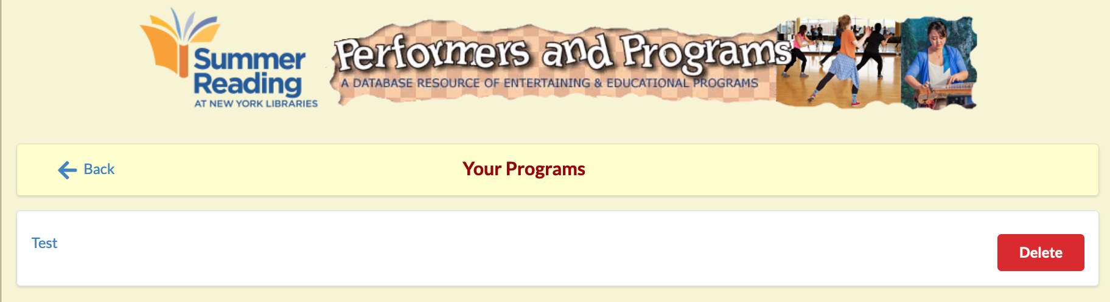
Program List
List of all programs
Edit by clicking
Deleting requires confirmation

Slide 23
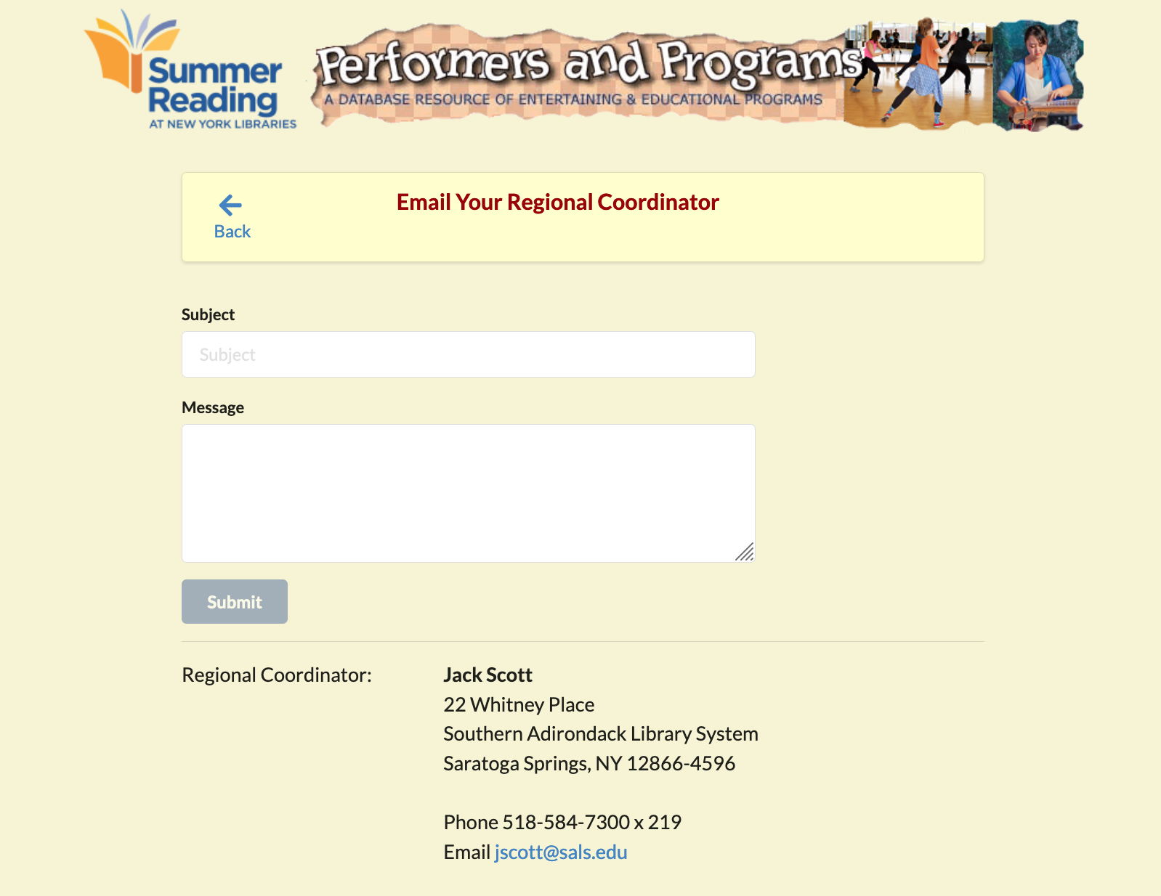
Performer Feedback
Sends email to Regional Coordinator
Lists contact info for more direct access

Slide 24
Questions?
PerformersAndPrograms.com

Slide 25

Conclusion
Thank you for participating – any questions?
A survey will be emailed to you shortly – please take a few minutes to respond. We truly appreciate your feedback!
https://www.surveymonkey.com/r/D7G6Q8R
Contact information for speakers:
  Peter Kowalski: petek@fastmail.com
  Sharon B. Phillips: Sharon.Phillips@nysed.gov

